Slide 1
Retrieving data from MySQL using PHP

Slide 2
Summary of the previous lecture
FILES super global variable
File uploading in PHP
Storing reference of uploaded file in database
CONNECTIONS: user registration with file upload

Slide 3
Outline
Retrieving data from MySQL using PHP
CONNECTIONS: login functionality

Slide 4
1. Retrieving data from MySQL using PHP
Connection with database
Execute Select SQL command
Make display structure
Write data

Slide 5
1.1 Connection with database
<?php
mysql_connect(“localhost”,”root”,””) or die(“Error in connection”);
mysql_select_db(“testdatabase”) or die(“Error in Selection”);
?>

Slide 6
1.2 Selecting data
SELECT command in SQL:
SELECT column-name
FROM table-name
SELECT user_Name
FROM users
SELECT *
FROM users

Slide 7
1.2 Selecting data…
Condition selection:
SELECT column-name
FROM table-name
WHERE condition
SELECT *
FROM users
WHERE user_Id>4

Slide 8
1.2 Selecting data…
<?php
include(‘connection.php’);
$sql = ‘select * from users’;
$result = mysql_query($sql);
?>

Slide 9
1.2 Selecting data…
Counting rows:
mysql_num_rows(variable);
<?php
include(‘connection.php’);
$sql = ‘select * from users’;
$result = mysql_query($sql);
$users = mysql_num_rows($result);
echo “There are total ”. $users .”users found”;
?>

Slide 10
1.3 Display structure
<table border=‘1’>
<tr>
<th> User Name</th>
<th> User Email</th>
<th> User Password</th>
<th> User Picture</th>
</tr>
<tr>
<td> &nbsp;</td>
<td> &nbsp;</td>
<td> &nbsp;</td>
<td> &nbsp;</td>
</tr>
</table>

Slide 11
1.4 Writing data
mysql_fetch_array(result-resource);
mysql_fetch_array($result);

Slide 12
1.4 Writing data…
$result=
1 | Ali | ali@yahoo.com | 123 | upload/123ali.jpg
2 | Umar | umar@yahoo.com | 123 | upload/123umar.jpg
$row = mysql_fetch_array($result);
0
1
2
3
4
1 | Ali | ali@yahoo.com | 123 | upload/123ali.jpg
$row=
user_Id
user_Name
user_Email
user_Password
user_Picture
echo $row [1];
echo $row[‘user_Name’];

Slide 13
1.4 Writing data…
User Name | User Email | User Password | User Picture
Ali | ali@yahoo.com | 123
<table border=‘1’>
<tr>
<th> User Name</th>
<th> User Email</th>
<th> User Password</th>
<th> User Picture</th>
</tr>
<tr>
<td> <?php echo $row[1]; ?> </td>
<td> <?php echo $row[2]; ?> </td>
<td> <?php echo $row[3]; ?> </td>
<td> <img src= “<?php echo $row[4]; ?>”> </td>
</tr>
</table>

Slide 14
1.4 Writing data…
<table border=‘1’>
Heading Row
<?php
while($rows = mysql_fetch_array($result))
{
?>
<tr>
<td> <?php echo $row[1]; ?> </td>
<td> <?php echo $row[2]; ?> </td>
<td> <?php echo $row[3]; ?> </td>
<td> <img src= “<?php echo $row[3]; ?>”> </td>
</tr>
<?php } ?>
</table>
User Name | User Email | User Password | User Picture
Ali | ali@yahoo.com | 123
Umar | umar@yahoo.com | 123

Slide 15
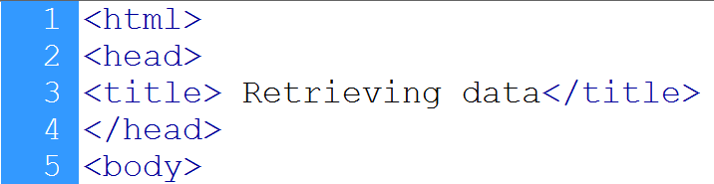


1.5 Example
Starts a HTML page
Connection to database
Select command
Query executed
Counting number of rows

Slide 16
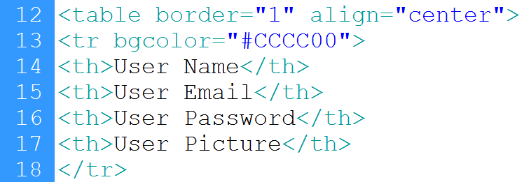
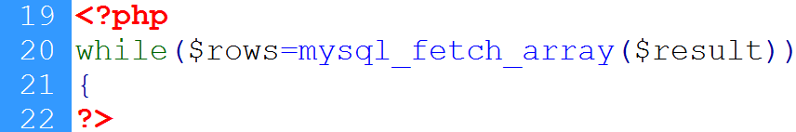
1.5 Example…
Heading row
Loop starts
Keeps row

Slide 17
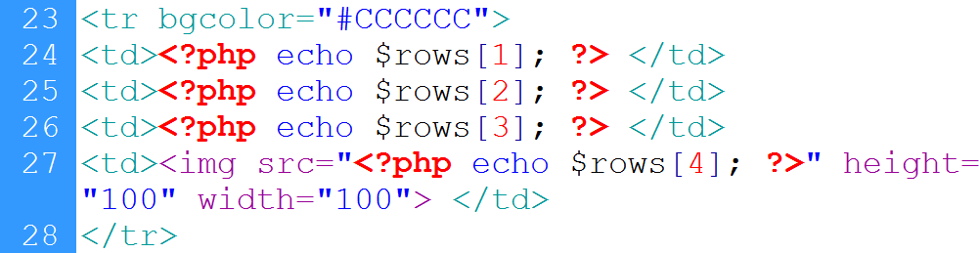
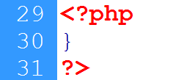
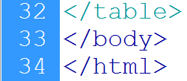
1.5 Example…
Displays name
Displays email
Displays password
Displays image
Sets source
Ends loop
Ends table

Slide 18
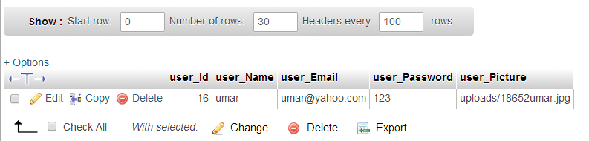
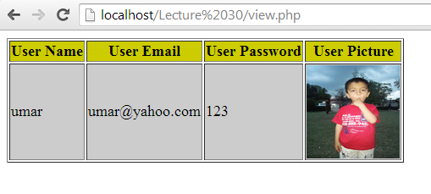
1.5 Example…
Records in user’s table
Output from the table

Slide 19
2. CONNECTIONS: User login
Form for user’s input
Login action page:
Connection with database
Retrieve user’s input
Select a record from user’s table with same email and password
Count the number of row in result
If one row is selected then fetch its values and store in session variable, otherwise send an error message on main page

Slide 20
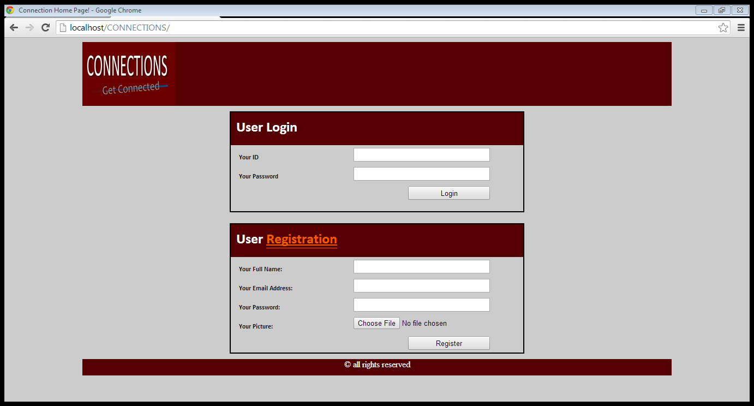
2.1 CONNECTIONS: User login form
Post method
email
Password

Slide 21
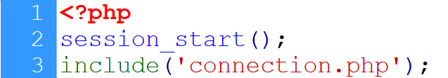
2.2 CONNECTIONS: database connection
<?php
mysql_connect(“localhost”,”root”,””) or die(“Error in connection”);
mysql_select_db(“testdatabase”) or die(“Error in Selection”);
?>

Slide 22
2.3 CONNECTIONS: Retrieve user’s input

Slide 23
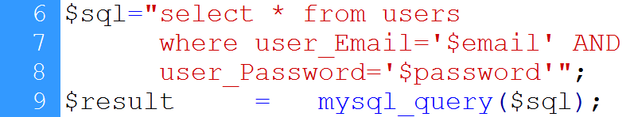
2.4 CONNECTIONS: Select record

Slide 24
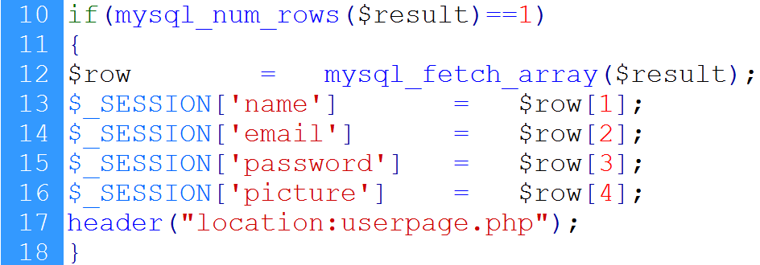
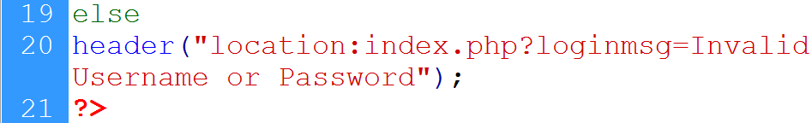
2.5 CONNECTIONS: Redirect
No. of rows selected
Fetch user information
Register session variables
redirect
If user’s input is invalid

Slide 25
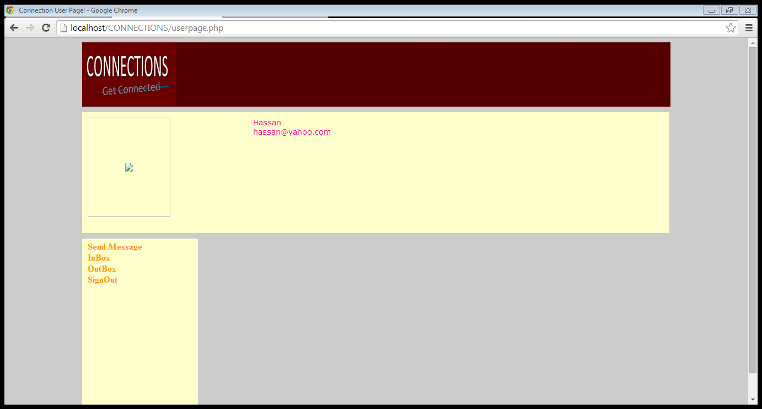
2.6 CONNECTIONS: user page
User’s pic
User profile
User’s information
actions

Slide 26
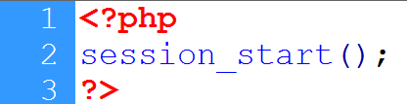
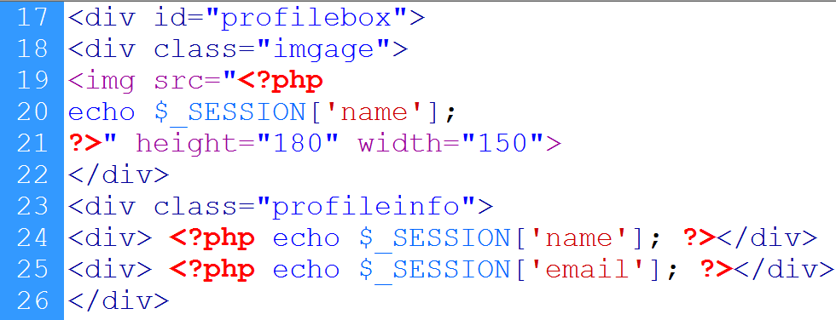
2.6 CONNECTIONS: user page…
‘picture’
Image div
Profile div
User’s info

Slide 27
Summary
Retrieving data from MySQL using PHP
CONNECTIONS: login page

Slide 28
References
Chapter 30, “Beginning PHP and MySQL” by W. Jason Gilmore, Apress publisher, 4th edition; 2010, ISBN-13 (electronic): 978-1-4302-3115-8.

